Slide 1

INTERNSHIP 2
WebSafe Security Scanner
AI/ML-Powered Platform for Real-Time Threat Detection and Web Vulnerability Analysis
Sub-Title / Description: Intel Unnati Internship Project – Network Security (AI/ML for Networking)
Presenter Name
Team Name: Teach Turtle's
MANU GOWDA (BU22CSEN0400211)
N. CHARAN (BU22CSEN0400151)
Mentor: Dr. Satish Kumar Mani (Associate Professor, Department of CSE)
Dept of Computer Science & Engineering

Slide 2
Abstract
WebSafe Security Scanner is a unified AI-powered platform designed to identify malicious URLs, detect SQL injection attacks, and classify network traffic threats in real-time.
It combines traditional security scanning with machine learning models trained on public datasets like CICIDS2017 and custom payloads.
The platform integrates multiple modules—web vulnerability scanner, URL classifier, and real-time packet analyzer—under a Django-based web interface.
ML models used include Logistic Regression, Naive Bayes, and Random Forest, achieving high accuracy with low inference latency.
WebSafe provides live monitoring dashboards, automated PDF reporting, and secure access controls, making it useful for security analysts, educators, and SOC environments.
Dept of Computer Science & Engineering

Slide 3
Certificate
Paste your internship Certificate
Dept of Computer Science & Engineering

Slide 4
Problem Statemt: AI/ML for Networking
Project Goal: Develop an AI/ML solution for automated network traffic analysis to enhance security and address challenges posed by data growth, encryption, and sophisticated threats.
Technical Requirements: Proficiency in Linux, Python/C programming, and basic AI/ML knowledge.
Expected Outcomes: Real-time traffic classification, improved threat detection, reduced false positives/negatives, scalability, and privacy-preserving analysis.
Network Traffic Analysis: Categorises network traffic based on behaviour and patterns.
Security Mechanism: Detects suspicious or malicious activity using AI.
Dept of Computer Science & Engineering

Slide 5
Project Objectives & Scope
Project Objective:
Develop AI/ML solutions to enhance network security by automating traffic analysis and improving threat detection.
Address challenges posed by data growth, encrypted communication, and sophisticated cyber threats.
Ensure real-time adaptive and intelligent network defence.
Project Scope:
Implement AI/ML models for automated network traffic analysis and classification.
Enhance threat detection and security by identifying anomalies, malware, and encrypted attacks.
Reduce false positives and negatives to improve network security operations efficiency.
Optimise scalability and performance for high-traffic environments with minimal latency.
Conduct privacy-preserving traffic analysis without decryption.
Deliver an AI-Powered Traffic Classification Model and a Threat Detection & Anomaly Identification Framework.
Dept of Computer Science & Engineering

Slide 6
Team & Contributions
Team Name: Teach Turtle's
Mentor: Dr. Satish Kumar Mani
Provided academic guidance and evaluation
Reviewed methodology and architecture design
Helped validate security considerations and research depth
Manu Gowda
Designed & developed the Django-based web interface
Integrated ML models for URL detection and traffic classification
Built the real-time packet monitoring engine using Scapy
Led UI/UX design, dashboard visualization, and PDF reporting
N. Charan
Performed feature engineering and dataset preparation
Trained and evaluated ML models: Logistic Regression, Naive Bayes, Random Forest
Worked on data preprocessing and model validation pipeline
Contributed to performance tuning and testing scripts
Dept of Computer Science & Engineering

Slide 7
Dataset & Feature Engineering
Datasets Used
CICIDS 2017 (Canadian Institute for Cybersecurity) → Used for training the Random Forest model to classify traffic into 7 classes (DoS, DDoS, Bot, etc.)
Custom Malicious URL Dataset → Collected from public GitHub repos & research papers → Labeled as benign or malicious
SQL Injection Payload Set → From OWASP, PayloadsAllTheThings, and manually created examples → Used for training the Naive Bayes model with TF-IDF vectorization
Feature Engineering
URL Classifier → Features: URL length, number of digits, entropy, special characters, IP address flag, script tag presence
SQL Injection Classifier → Features: TF-IDF features extracted from raw SQL payloads (unigrams & bigrams)
Traffic Classifier → Features: Flow duration, packet length, header length, protocol flags, inter-arrival time, active/idle time
Dept of Computer Science & Engineering

Slide 8
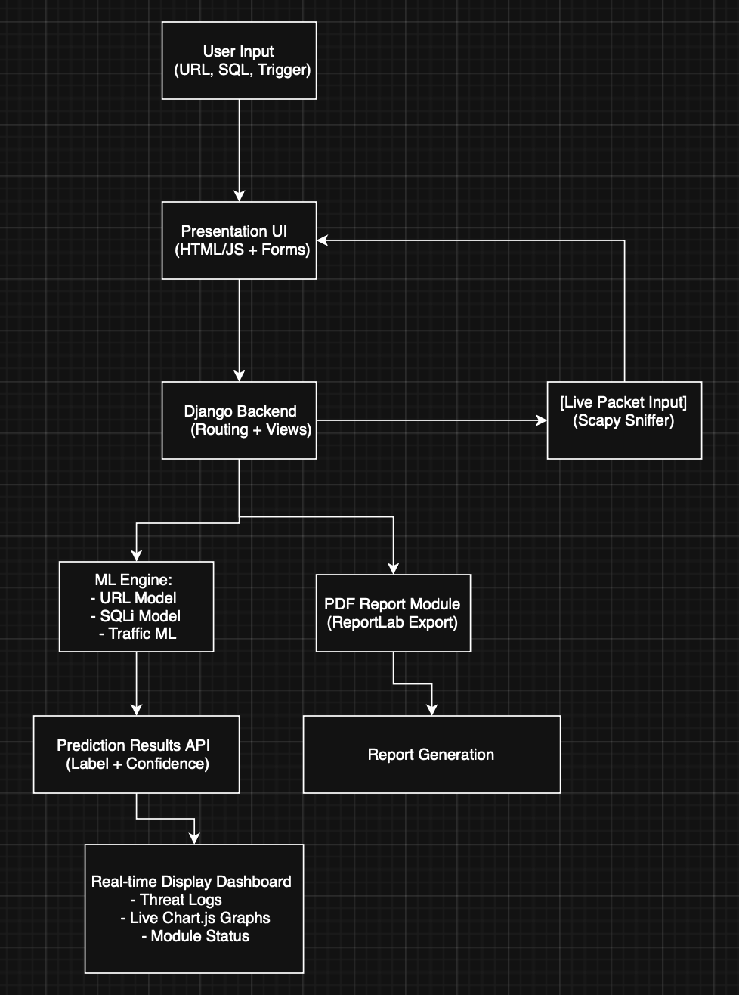
System Architecture
Layers of the System
Frontend: HTML, CSS, JS + Chart.js for visualizations
Backend: Django handles routing, model API, and session management
ML Models:
URL → Logistic Regression
SQLi → Naive Bayes
Traffic → Random Forest
Live Monitor: Scapy captures packets in real time and classifies flows
Reporting: Generates PDF reports and logs using ReportLab & SQLite
Dept of Computer Science & Engineering

Slide 9
ML Models & Evaluation
Models Used
Logistic Regression → Malicious URL classification → Accuracy: 97%
Naive Bayes → SQL Injection detection (using TF-IDF) → Accuracy: 96%
Random Forest → Network traffic classification (7 classes) → Accuracy: 99.85%
Evaluation Highlights
🚀 Inference time: <100 ms
📉 Low false positives & high recall
✅ Tested on real and synthetic data
📊 Confusion matrices showed strong class-wise performance
Dept of Computer Science & Engineering

Slide 10
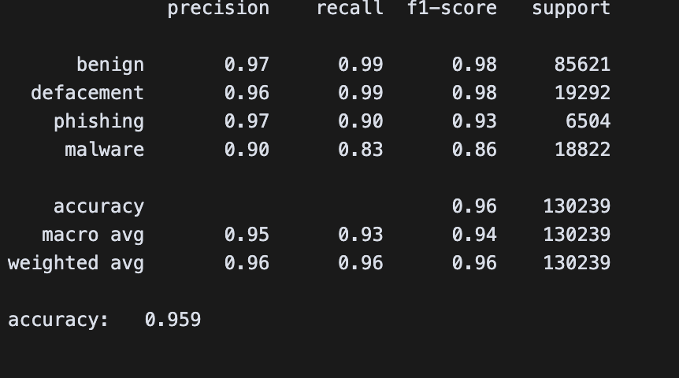
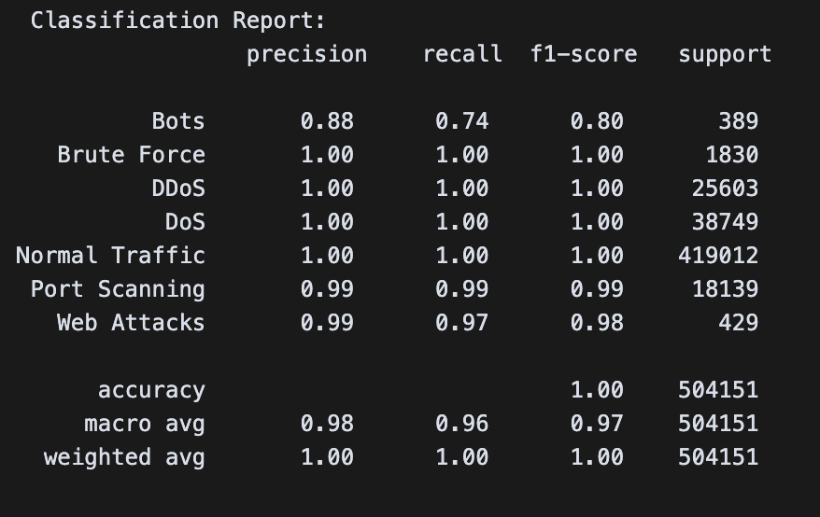
ML Models & Evaluation
Malicious_URL_Detection_System
Live_Network_Analysis_Train_Model
Dept of Computer Science & Engineering

Slide 11
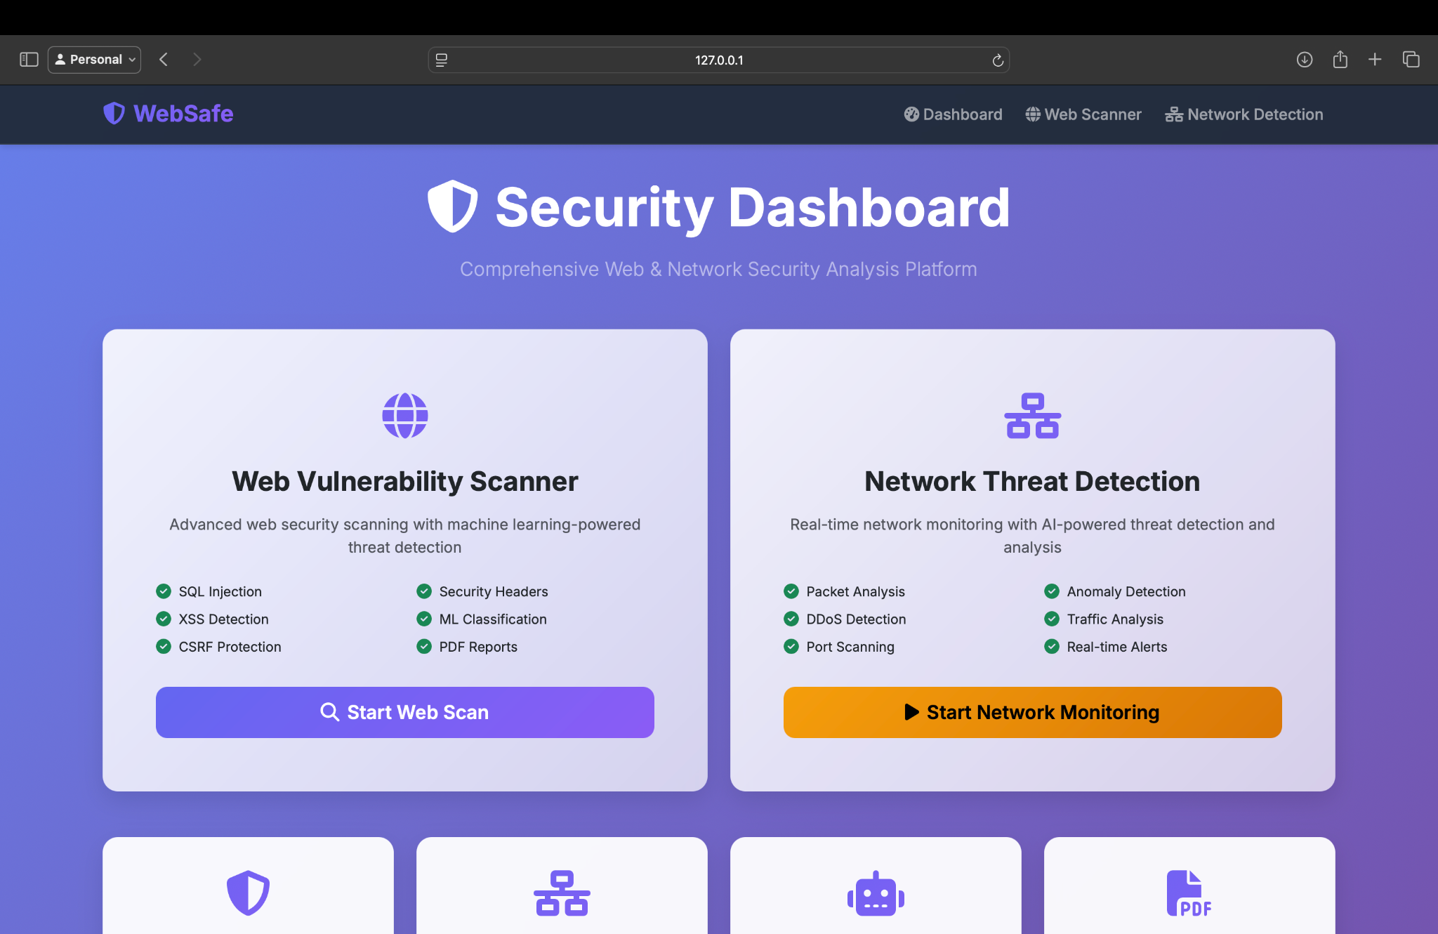
Web App & Interface
Frontend Features
📄 Built using Django + Bootstrap
📊 Real-time threat dashboard (Chart.js)
📝 Input forms for:
URL scanning
SQLi testing
Live traffic monitoring
Tech Stack Summary
Django (Backend)
HTML/CSS + JS (Frontend)
SQLite (Storage)
ReportLab (PDF Export)
User Interactions
One-click scan & classify
Downloadable PDF reports
Session-based scan logs
Live alerts for detected threats
Dept of Computer Science & Engineering

Slide 12
Performance & Testing
Performance Metrics of the model
Performance Indicators (KPIs) of the Application
Model Type | Accuracy | Precision | Recall | F1-Score | Avg. Inference Time
URL Classifier | 97% | 0.96 | 0.95 | 0.97 | <100 ms
SQLi Classifier | 97% | 0.98 | 0.96 | 0.97 | <50 ms
Traffic Classifier | 99.85% | >0.98 | >0.97 | >0.98 | <50 ms/flow
Metric | Target Value | Achieved Value
URL Prediction Time | < 100 ms | 83 ms avg
SQLi Prediction Time | < 75 ms | 51 ms avg
Network Flow Prediction | < 50 ms | 37 ms avg
Dashboard Load Time | < 2 seconds | 1.5 seconds
PDF Generation Time | < 3 seconds | 2.1 seconds
System Uptime (4 hrs) | 100% | 100%
False Positive Rate | < 5% | 3.7% (avg)
Memory Usage (under load) | < 2 GB | 1.4 GB
Dept of Computer Science & Engineering

Slide 13
Use Cases & Future Scope
Use Cases
Web App Security: Detect SQLi, XSS, CSRF
Malicious URL Scanning: Email/Chat filters
Network Traffic Monitoring: Detect DoS, Botnets
Education & Training: Hands-on lab tool
Compliance Auditing: Exportable PDF reports
Future Scope
Integrate Deep Learning Models (CNN/LSTM for anomaly detection)
Docker + Cloud Deployment (Kubernetes, AWS)
SIEM Integration (Splunk, ELK stack)
Live Alerts via email/webhooks
Community Threat Sharing Portal
Dept of Computer Science & Engineering

Slide 14
Thank You
Dept of Computer Science & Engineering

